Slide 1
FUTURE GADGETS LAB
THEME: Electric Vehicle
SATVIK KAUL
TANISH BHOLA
TARUN LAHROD

Slide 2
The idea
A Progressive Web-App for users to facilitate them with E-Vehicle charging services.
Artificial Intelligent app predicting waiting time and dynamic price(optional) on the basis of features such as numberOfCars, Time etc.

Slide 3
Why a Progressive Web-App?
No need to install one more application.
Very easy to access.
Can be directly invoked from GOOGLE ASSISTANT.

Slide 4
Features
Dynamic Pricing
Waiting time prediction
Future Aspects
Slot booking
E-mail and sms notification alert of charging status.

Slide 5
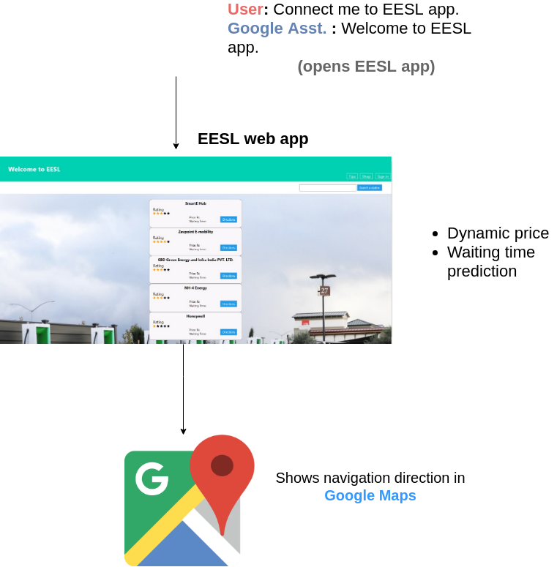
Flowchart

Slide 6
Business Model
Advertisements :
We can advertise the EV related products on our progressive Web-App and can generate revenues from these ads.
Providing our platform to other Ev-Stations:
If our app gets famous enough then we can let other providers use our platform to list their EV stations and in return we can ask for a fair percentage of that revenue.

Slide 7
Thank You

